Slide 1
Radioactive substances
Robert G. Hendrickson, MD
Department of Emergency Medicine
Oregon Health and Science University
Oregon Poison Center

Slide 2
Objectives
Discuss principles of radiation
Acute exposure
Acute radiation illness
Industrial accident, “dirty bomb” or acute exposure
Chronic exposure
Radon and other common isotopes
Cancer risk

Slide 3
Ionizing Radiation
Ionizing radiation is radiation that is capable of transferring its energy to human tissue and imparting chemical changes (breaking chemical bonds)
Courtesy of Lawrence Livermore Natl Lab
Notes:
Non-ionizing radiation is not energetic enough to transfer its energy to human tissue. An example is radio waves.

Slide 4
Types of Ionizing Radiation
Particles or waves
Particles
Alpha
Beta
Neutrons
Electromagnetic waves
Gamma
X-rays

Slide 5
Types of ionizing radiation
Alpha particles
2 neutrons & 2 protons
Cm in air / blocked by paper
+
Beta particles
Electron
M in air /mm in tissue / blocked by glass
-
Neutron particle
1 neutron
Very penetrating
Notes:
Alpha and beta are commonly discharged from radioisotopes
Neutrons are typically only seen after nuclear fission – so a nuclear detonation or at a nuclear power facility

Slide 6
Types of ionizing radiation
Gamma Rays
Electromagnetic energy emitted from nucleus
Very penetrating - requires lead (~30mm)
X-Rays
Energy emitted from the electrons
Very penetrating - requires lead
Notes:
Xrays and gamma rays are the same thing. They only differ in how they are created. Once emitted, there is no difference.
Gamma radiation is emitted by unstable radioisotopes
Xrays are emitted when an xray machine accelerates electrons through a large voltage and collides them into a heavy metal object. The collision/deceleration of electrons, produces and emits xrays.

Slide 7
Common radionuclides
 | Alpha | Beta | Gamma
Cesium 137 |  | X | X
Cobalt 60 |  | X | X
Iodine 131 |  | X | X
Plutonium | X | X | X
Strontium 90 |  | X
Technetium 99 |  | X | X
Uranium | X |  | X

Slide 8
Units of Measure
Gray (or rad) (1 Gray = 100 rads)
Units of absorbed dose
Amount of energy deposited in matter
Sievert (or rem)(1 Sievert = 100 rem)
Dose equivalent – biological effect
Absorbed dose weighted by the type of radiation and type of tissue
Biological effect by radiation type
In most instances, 1 Gray = 1 Sievert
Notes:
Roentgen – unit for measuring the amount of radiation produced
Rad – absorbed dose of radiation
Rem – corrects for different types of radiation b/c they have different effects on biological tissue
a given number of Gray (or rads) of xrays produce less cellular damage than alpha particles do. The higher the energy or size, the higher the biological effect
Q = Quality factor = correction factor for different radiation types
1 = xrays, beta, gamma radiation, xradiation
20 = alpha particles
5 = neutrons

Slide 9
Background Radiation
Background radiation
350 mrem/yr
3.5 mSv/yr
Photo courtesy of Lawrence Livermore Natl Lab

Slide 10
Background radiation
Sources – natural sources= 3mSv (80%)
Uranium, thorium, actinium in earth’s crust
Radon
K40 – in food
Man-made sources
Medical sources = .5mSv, (15%)
Physicians/nurses:
Fluoroscopy = .05-.3 mSv / procedure

Slide 11
Everyday/Medical Radiation
Air travel – Transcontinental
Chest x-ray (collimated field)
Rec. limit during pregnancy
CT body
Annual limit - radiation worker
Therapeutic thyroid tx
Acute radiation syndrome (mild)
LD 50/60 humans
.05 mSv
.1 mSv
5 mSv
10 mSv
50 mSv/yr
70 mSv
2000 mSv
5,000 mSv

Slide 12
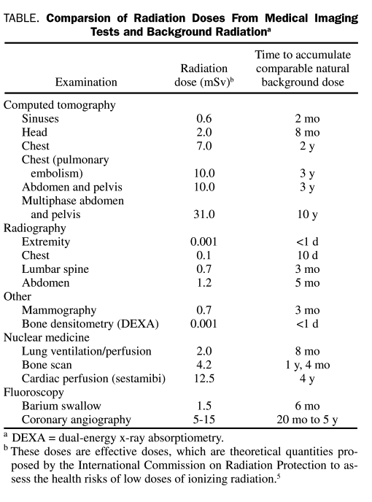
Everyday/Medical Radiation
Mayo Clin Proc 2010; 85(10): 1142-6

Slide 13
How can people become exposed to additional radiation?

Slide 14
Types of Radiation Exposure
External exposure
Contamination
External
Internal
Incorporation

Slide 15
Types of Radiation Exposure
External exposure

Slide 16
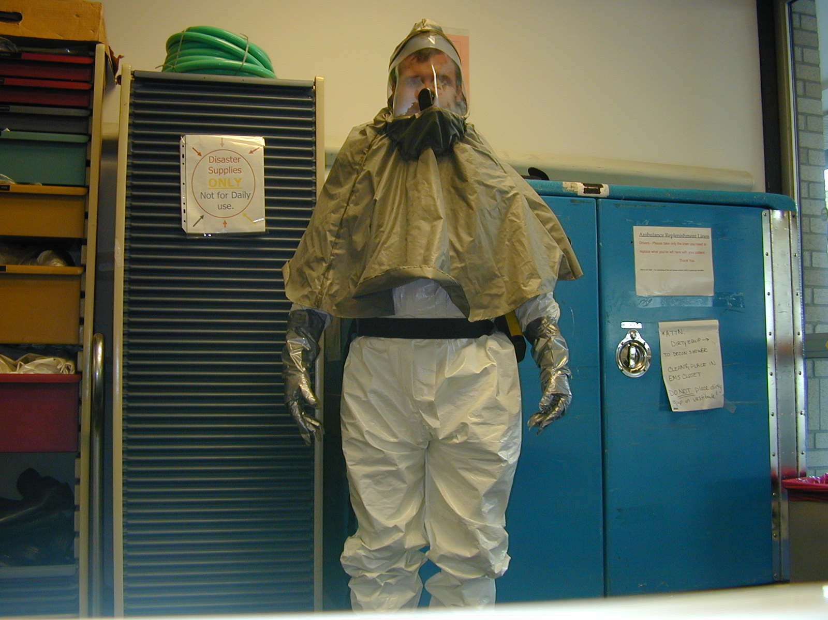
Types of Radiation Exposure
External exposure
Contamination
External

Slide 17
Types of Radiation Exposure
External exposure
Contamination
External
Internal

Slide 18
Types of Radiation Exposure
External exposure
Contamination
External
Internal
Incorporation

Slide 19
Can we use potential industrial accidents or terrorist acts to better understand exposure, contamination, and incorportation?

Slide 20
How might a terrorist expose people to radiation?
Simple radiological device
Nuclear reactor explosion
Radiological dispersion device
Nuclear device

Slide 21
How might a terrorist expose people to radiation?
Simple radiological device
Whole body or local exposure
No contamination

Slide 22
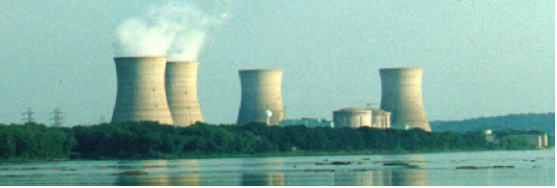
How might a terrorist expose people to radiation?
Nuclear reactor explosion / criticality
No or little exposure
Possible external and internal contamination

Slide 23
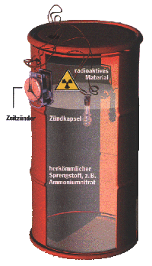
How might a terrorist expose people to radiation?
Radiological dispersion device
No or little exposure
Possible external and internal contamination

Slide 24
How might a terrorist expose people to radiation?
Nuclear device
Exposure
Possible internal and external contamination

Slide 25
What are the commonly available sources of radioisotope?

Slide 26
Commonly available radioisotopes
Industry
Cesium 137 (flow measure in pipelines)
Iridium 192 (to check weld integrity)
Radium 226 (lightning rods)
Household
Tritium (exit signs, luminous dials)
Americium (smoke detectors)
Thorium 232 (gas lantern mantles)
Hospitals
Technetium 99 (bone/biliary/VQ scan, venograms, sestamibi)
Iodine 123 (thyroid scan)
Strontium 85 (bone studies)
Xenon 133 (VQ scan)

Slide 27
What are the medical effects of radiation???

Slide 28
Radiation may cause damage to cells
Radioisotopes may transfer energy to cells and damage DNA
Direct cleavage of bonds
Energy deposited in water molecules
Form hydroxyl radicals (OH.)
Free radical damage
Bystander effect
Cells that juxtapose irradiated cells develop chromosomal abn due to gap junction connections
Notes:
High LET radiation (e.g. alpha particles) are larger and more likely to collide with tissue and transfer energy. They more likely will cause direct DNA damage b/c they are more likely to directly collide with DNA.
Low LET radiation (xray, gamma, electrons) are less likely to collide directly with DNA, but cause indirect damage by colliding with other, more common molecules (e.g. water), to produce reactive species
water -> hydroxyl radical (OH.) and causes molectular damage

Slide 29
How come we don’t fall apart?
Humans are incredibly resilient
Each cell in our body has a DNA break about every 10 seconds
10s of millions of DNA breaks per year
Our cells have DNA repair mechanisms
Acute radiation effects ONLY occur if exposure overwhelms repair

Slide 30
Stochastic v deterministic
Stochastic – injury does not require threshold limit to be exceeded
A single unit of radiation may cause a chromosomal abnormality that will eventually lead to cancer
Theory: “there is no safe dose of radiation”
Deterministic – threshold limit
A relatively large percentage of cells in an organ must be affected prior to organ dysfunction
Until that threshold is met, no detectable organ dysfunction

Slide 31
Medical effects
External exposures -
Whole body dose:
Acute radiation syndrome (ARS)
Risk of chronic effects
Local dose:
Local effects
Contamination:
Minimal risk of acute radiation syndrome
Risk of incorporation and chronic effects

Slide 32
Acute Radiation Syndrome
Acute Illness caused by exposure to whole body radiation over a short period of time (excess of 1 Sv)
Nuclear blast
Whole body exposure

Slide 33
ARS Predictable Course
Prodromal - onset dependent on dose
Nausea, vomiting, malaise
Latent - days to weeks
Bone marrow suppression
Illness phase
Infection, bleeding
Recovery or death
Relation of dose & symptoms
Higher the dose, the faster onset of sxs
Higher the dose, the longer sxs last

Slide 34
Syndromes
Clinical effects of acute radiation are dose dependent
< 1Gy (100rad) – no ARS
> 1Gy = hematologic syndrome
> 6Gy = gastrointestinal syndrome, pulmonary syndrome
>15Gy = cerebrovascular syndrome
>10-20Gy = 100% mortality
Notes:
Historically, there is > 100% mortality with exposures > 10Gy

Slide 35
Syndromes
Hematologic syndrome
> 1 Gy
Panctopenia
Lymphocytes are first to decrease
Nadir is 8-30 days
Used as prognostic factor
Notes:
Historically, there is > 100% mortality with exposures > 10Gy

Slide 36
Syndromes
Gastrointestinal syndrome (>6Gy)
N/V/D/sloughing of mucosa
Hypersecretion of fluids into lumen
Leads to dehydration and sepsis
Pulmonary syndrome (>6Gy)
Pneumonitis within 1-3 months
May lead to fibrosis and respiratory failure
Notes:
Historically, there is > 100% mortality with exposures > 10Gy

Slide 37
Syndromes
CNS syndrome (>15Gy)
Pyrexia, ataxia, CNS sedation, seizures
Hypotension
Universally fatal
Notes:
Historically, there is > 100% mortality with exposures > 10Gy

Slide 38
How are patients with ARS treated?

Slide 39
How are patients with ARS treated?
Estimate dose
Dose (Gy) | Onset of vomting (hours) | Rate constant (K) for lymphocyte depletion | Dicentric chromosomes in lymphocytes (per 1000 cells)
0 | n/a | n/a | 102
1 | >24 | 0.126 | 88
2 | 4.5 | 0.252 | 234
3 | 2.5 | 0.378 | 439
4 | 1.75 | 0.5 | 703
5 | 1.25 | 0.63 | 1024

Slide 40
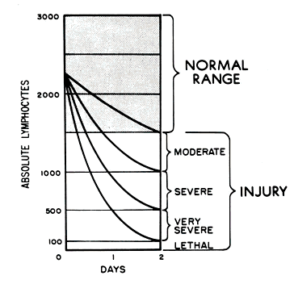
How are patients with ARS treated?
Estimate dose
Andrews lymphocyte depletion curve

Slide 41
How are patients with ARS treated?
Estimate dose
Diagnostic tests
CBC
Type and cross

Slide 42
How are patients with ARS treated?
Estimate dose
Diagnostic tests
Supportive care
Anti-emetics
Antibiotics
GM-CSF
Blood products - irradiated
Neutropenic precautions
Surgery must be performed within 2 days, or after 3 months

Slide 43
Local dose
Local exposure may lead to:
Local skin and soft-tissue damage
Erythema, edema, necrosis - looks like a thermal or chemical burn
Occurs days after exposure
Arterial insufficiency
Occurs months / years later

Slide 44
Local dose

Slide 45
What about the contaminated patient?

Slide 46
Radiological contamination
Contamination
Explosion in industrial or hospital setting.
“Dirty bomb” [“Radiological dispersal device (RDD)”]

Slide 47
“Dirty bomb”?
Conventional explosive device combined with a radioisotope
The radioisotope is dispersed over an area during the explosion
The main acute effect is TRAUMA

Slide 48
Radioisotope explosions
Explosions involving radioisotope (‘dirty bomb’ or industrial explosion) do not cause acute radiation effects (ARS)
However, they may produce contamination that may lead to an increased risk of long-term effects (e.g. cancer and teratology) if the radioisotope is ingested, inhaled or absorbed through wounds.

Slide 49
Radioisotope Explosion Patient Management
First priority is trauma/medical evaluation
Should not be delayed for “radiation evaluation”
The amount of isotope on a single patient is miniscule and is not harmful unless inhaled, swallowed, or in contact with skin

Slide 50
Radioisotope Explosion Patient Management
Main difference between the acute care of a victim of an explosion involving radioisotope and a victim of a conventional explosive is DECONTAMINATION.

Slide 51
Contaminated Patient Management
External decontamination
Removal of clothing
Soap and water ~2-3 minutes
For most patients, no other therapy will be necessary

Slide 52
Patient Management
Contaminated patients should be surveyed with a Geiger-Muller counter (survey meter)

Slide 53
Patient Management
For high risk patients:
Assess for exposure and incorporation
Consultation with radiation safety officer
Nasal, gastric, wound swabs
Urine/Fecal collection
Use this data to determine risk of internal contamination, incorporation, and cancer/fetal risk

Slide 54
Patient Management
Internal decontamination
Broncho-alveolar lavage
Gastric lavage
Radium - 10% magnesium sulfate
Activated charcoal
Whole-bowel irrigation
Gastrointestinal binding…

Slide 55
Patient Management
Radionuclide | Chelator | Mechanism
Cesium - 137 Rubidium Thallium | Prussian Blue [Ferrihexacyano-Ferrate (II)] 1 g PO qd x 3 | GI binding decreases absorption
Phosphorous - 32 | Aluminum hydroxide | GI binding decreases absorption
Radium - 226 | 10% magnesium sulfate lavage | GI binding decreases absorption
Strontium - 90 | Aluminum phosphate | GI binding decreases absorption (by 85%)
Notes:
Cs137 – moisture gauges, flow gauges, thickness gauges, cancer
Rubidium – purple fireworks, thermoelectric generators, laser cooling and Bose-Einstein condensation devices
Thallium – optics, photoresistors, superconductors for magnetic propulsion or MRI, stress test
Phosphorous 32 – nuclear medicine, biochemistry labs (to trace Phos)
Radium – industrial radiography devices (xrays to check welds)
Strontium 90 – thickness gauges, power supply for space vehicles

Slide 56
Patient Management
Incorporation
Consider antidotal therapy
Radionuclide | Antidote | Dose | Mechanism
Iodine | Potassium Iodide PTU | 300mg qd 100mg TID x 2d | Blocks thyroid deposition Reduce thyroid iodine retention
Plutonium Yttrium Americium | Zn-DTPA Ca-DTPA | 1 g in 250cc D5W IV over 60 min | Chelator other chelators?
Uranium | Sodium bicarbonate | Bicarbonate drip (or PO) | Alkalinization of urine
Tritium | Water/saline | Forced diuresis | Dilution/diuresis
Notes:
Yttrium – TV picture tubes, catalyst in ehtylene polymerization, high performance spark plugs, gas mantles, adhered to monoclonal antibodies for lymphoma, leukemia, pancreatic, and bone cancers
Americium – smoke detectors, gauges, thickness gauges, nondestructive testing of materials/machinery
Tritium – aircraft and commercial exit signs, luminous gauges

Slide 57
What is the risk of cancer from radiation?

Slide 58
Cancer risk from radiation
Chernobyl – increased rates of
Leukemia (except CLL)
Breast carcinoma
Thyroid cancer
Radon
12 fold increase risk of lung cancer in uranium miners

Slide 59
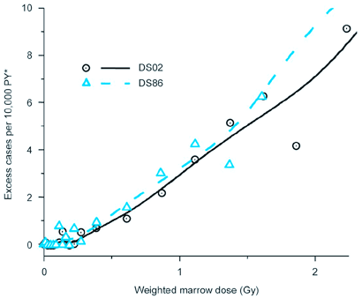
Cancer risk from radiation
Hiroshima/Nagasaki
Increased risk over 100mSv (100mGy)
Additional 4.8 cases of leukemia for every 1000 people exposed to 0.5-1 Gy (50-100 PE protocol CTs)
All other data are extrapolations
“linear no-threshold theory”
5% increased risk of death with a 1000mSv dose
100 PE protocol CTs
Risk of leukemia in “A bomb survivors”, Japan
Radiation effects research center, www.refr.jp
Notes:
CT abdomen = 10 mSv

Slide 60
What is the risk of cancer from a “dirty bomb” or industrial explosion?
Simulated Cesium-137 dirty bomb
Notes:
Baseline cancer death rate is 30%, so being struck by a dirty bomb may make that risk 31%.

Slide 61
Conclusion
In an industrial accident,
the main risk to the patient is trauma
Patients should be decontaminated to remove radioisotope particles
There is very little medical risk to HCW or the patient from radioisotopes unless there is internal contamination and incorporation.

Slide 62
Conclusion
In nuclear explosions or nuclear power plant meltdowns, the risk is both contamination and exposure
Patients require decontamination and evaluation for
acute radiation illness
internal contamination
incorporation

Slide 63
Questions?

Slide 64
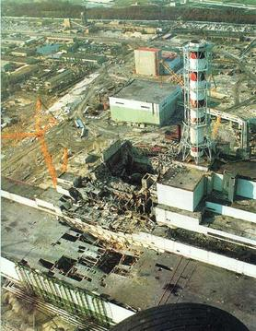
Chernobyl, Ukraine
1986
Fire in nuclear reactor led to explosions and criticality
I¹³¹ and Cs¹³⁷
31 died of ARS
250 hospitalized
Increases in thyroid cancer due to ingestion of food
Estimated 1000 cases of thyroid cancer
Estimated 4000 cases of other cancers
Notes:
The disaster began during a systems test on Saturday, 26 April 1986 at reactor number four of the Chernobyl plant, which is near the city of Pripyat and in proximity to the administrative border with Belarus and the Dnieper river. There was a sudden and unexpected power surge, and when an emergency shutdown was attempted, an exponentially larger spike in power output occurred, which led to a reactor vessel rupture and a series of steam explosions. These events exposed the graphite moderator of the reactor to air, causing it to ignite.^{[5]} The resulting fire sent a plume of highly radioactive fallout into the atmosphere and over an extensive geographical area, including Pripyat. The plume drifted over large parts of the western Soviet Union and Europe. From 1986 to 2000, 350,400 people were evacuated and resettled from the most severely contaminated areas of Belarus, Russia, and Ukraine.^{[6][7]} According to official post-Soviet data,^{[8][9]} about 60% of the fallout landed in Belarus.

Slide 65
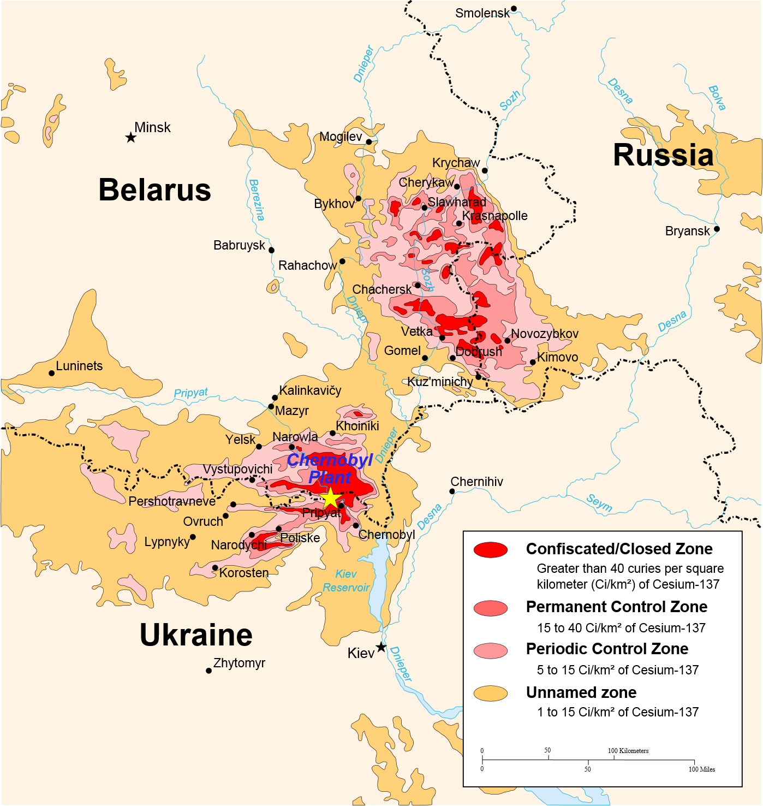
Notes:
The disaster began during a systems test on Saturday, 26 April 1986 at reactor number four of the Chernobyl plant, which is near the city of Pripyat and in proximity to the administrative border with Belarus and the Dnieper river. There was a sudden and unexpected power surge, and when an emergency shutdown was attempted, an exponentially larger spike in power output occurred, which led to a reactor vessel rupture and a series of steam explosions. These events exposed the graphite moderator of the reactor to air, causing it to ignite.^{[5]} The resulting fire sent a plume of highly radioactive fallout into the atmosphere and over an extensive geographical area, including Pripyat. The plume drifted over large parts of the western Soviet Union and Europe. From 1986 to 2000, 350,400 people were evacuated and resettled from the most severely contaminated areas of Belarus, Russia, and Ukraine.^{[6][7]} According to official post-Soviet data,^{[8][9]} about 60% of the fallout landed in Belarus.

Slide 66
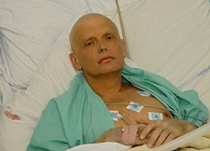
Alexander Litvinenko
Former Soviet KGB operative living in London
November 1, 2006
N/V shortly after a few meetings
Seen in ED and released
Returned 3 days later with N/V/Abd pain
Then developed alopecia, hypotension, renal failure, and leukopenia
Died 26 days later
Polonium (Po²¹⁰)

Slide 67
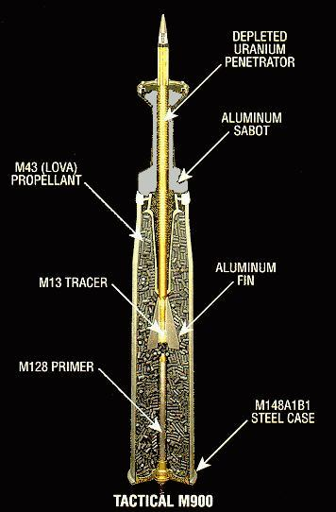
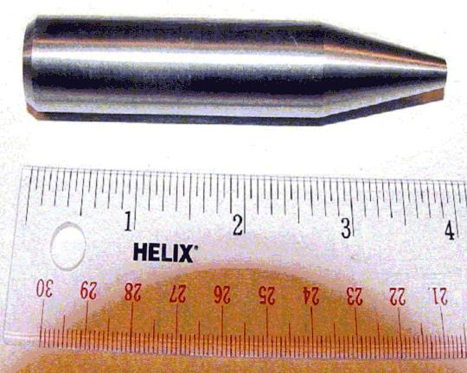
Depleted uranium
Used by US and other militaries for armor piercing munitions
Very dense (1.7 times more dense than lead)
Self-sharpening
Then disintegrates and ignites (pyrophoric)
Byproduct of enriched uranium from nuclear reactors
1/3 of the U-235 / 238 than natural uranium
Alpha emitter, but low energy (t1/2=70mill years)
US = “no cancer risk”
UK = “increased risk of lung/lymphatic cancer”
Notes:
Pyrophoric – ingites spontaneously

